Slide 1


CHURN
PREDICTION
Guided By : Prof Yugandhara Pande
AIML161 : Dheeraj Yadav
AIML154 : Abhishhek Velankar
AIML144 : Abdul Shaikh
AIML145 : Aditya Sharma

Slide 2
3
Literature Survey
Introduction
This project constructs a deployable interface for telecommunication churn forecasting, empowering companies to upload datasets for large-scale prediction, analysis, and visual reporting
1
Problem Statement
Excessive customer departures in telecom services cause major revenue drops, demanding precise prediction tools and clear data insights."
2
Abstract
A machine learning model, deployed via Streamlit, predicts customer churn and performs exploratory data analysis, aiding in retention strategy development.

Slide 3
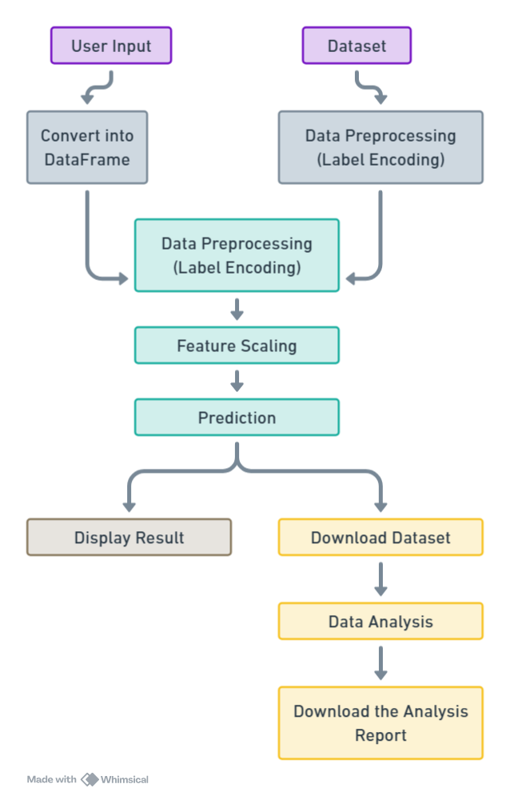
4
Methodology
3
Prposed System
Customer churn poses a critical challenge for businesses, leading to revenue loss and high customer acquisition costs. Predicting churn enables targeted retention strategies to keep valuable customers.
This project aims to build a machine learning model that classifies customers as likely to churn or not based on demographics, contract details, and service usage, helping businesses retain customers and enhance sustainability.
6
Future work
5
Objective
To develop a machine learning model that predicts customer churn, enabling businesses to identify at-risk customers, reduce revenue loss, and improve retention.
Future work can explore deep learning for improved accuracy, real-time predictions for proactive retention, and integration of customer feedback for richer insights.
Organizing and planning
5
Organizing and planning
5

